Slide 1

EE-371 : Control Systems
Lecture#24
7.3 Static Error Constants and
System Type
7.4 Steady-State Error Specifications
7.5 Steady-State Error for Disturbances
Textbook: Chapter # 07 (5th edition)
Text Book: Control Systems Engineering by Norman S. Nise 5th Edition
Instructor: Ms Neelma Naz
Class: BEE 12 C/D
School of Electrical Engineering and Computer Science
Department of Electrical Engineering

Slide 2
7.3 Static Error Constants and
System Type

Slide 3
unity negative feedback systems
Performance specifications for the transient response
damping ratio,
natural frequency,
settling time,
percent overshoot,
Peak time
Rise time
Parameters that can be used as steady-state error performance specifications, are called
static error constants

Slide 4
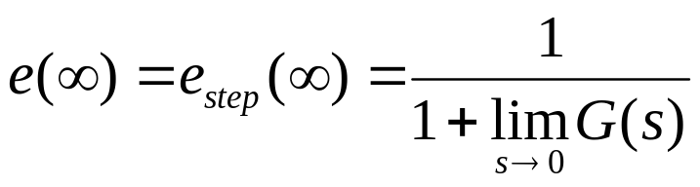
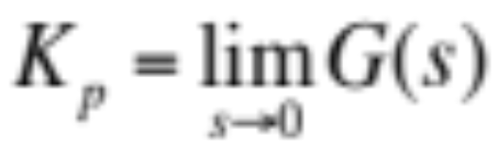
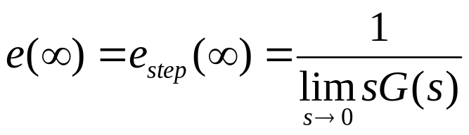
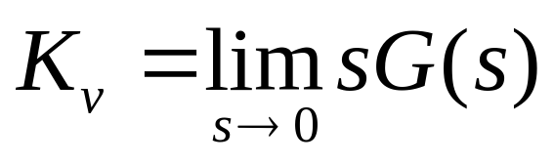
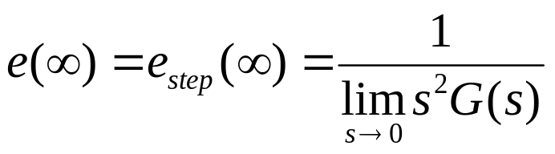
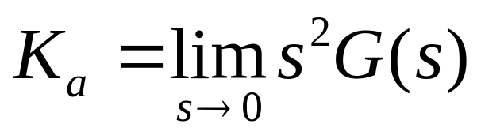
Static Error Constants
The three terms in the denominator that are taken to the limit determine the steady-state error.
These limits are the static error constants.
For a step input, u(t),
Position Constant, Kp
For a ramp input, tu(t),
Velocity Constant, Kv
For a parabolic input, ½ t²u(t).
Acceleration Constant, Ka

Slide 5
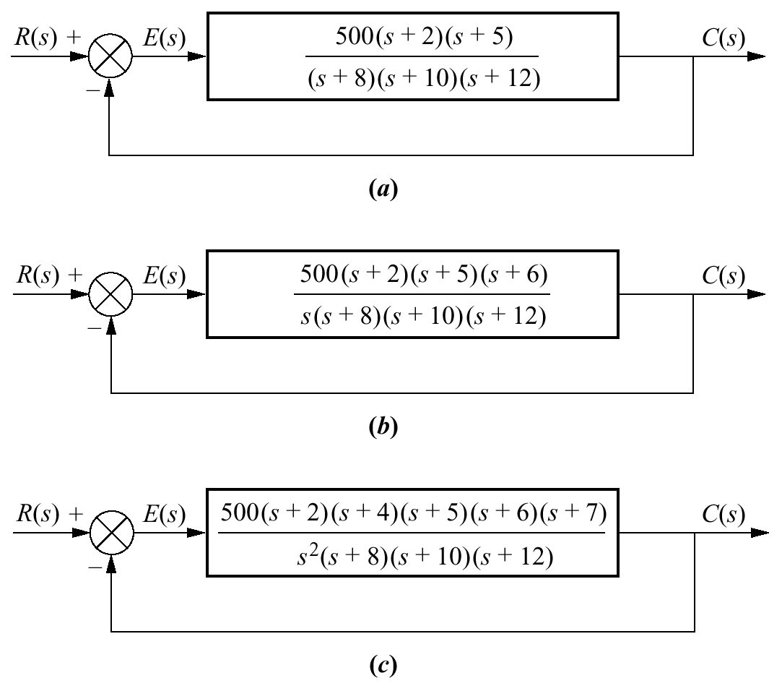
Steady-State Error via Static Error Constants
Example 7.4
PROBLEM:
For each system in the Figure, evaluate the static error constants and find the expected error for the standard step, ramp, and parabolic inputs.

Slide 6
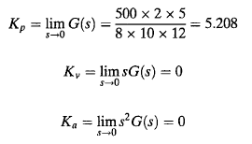
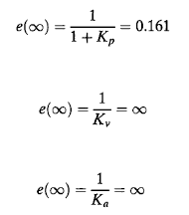

Slide 7
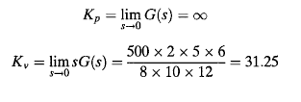
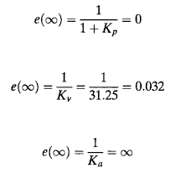


Slide 8
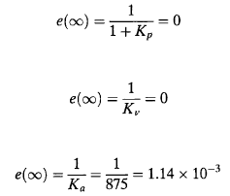
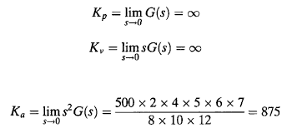

Slide 9
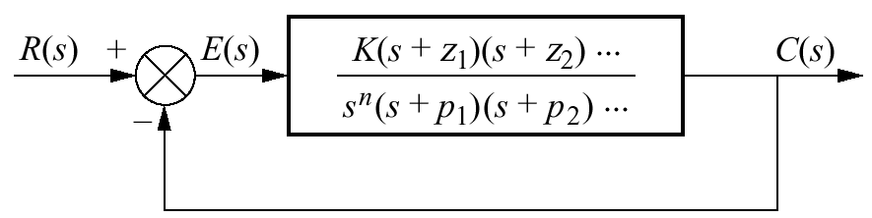
System Type
unity negative feedback systems
Since steady-state errors are dependent upon the number of integrations in the forward path, a name is given to this system attribute
system type is defined to be the value of n in the denominator.
Thus:
a system with n = 0 is a Type 0 system
n = 1 is a Type 1 system
n = 2 is a Type 2 system

Slide 10
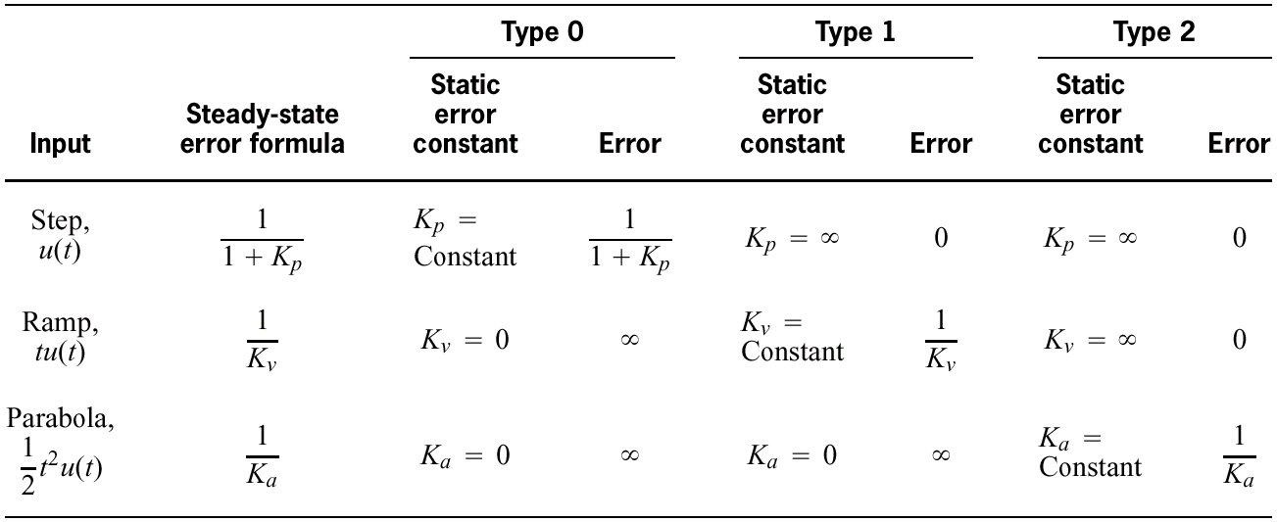
Table 7.2
Relationships between input, system type, static error constants, and steady-state errors

Slide 11
7.4 Steady-State Error Specifications

Slide 12
Just as
damping ratio, ζ
settling time, T_{s}
peak time, T_{p}
percent overshoot, % OS
are used as specifications for a control system's
transient response
Position constant, K_{p}
Velocity constant, K_{v}
Acceleration constant, K_{a}
are used as specifications for a control system's steady-state errors

Slide 13

Wealth of information contained within the specification of a static error constant
For example, if a control system has the specification Kv = 1000,
we can draw several conclusions:
1. The system is stable.
2. The system is of Type 1, since only Type 1 systems have Kv's that are finite constants.
Recall that Kv = 0 for Type 0 systems
Kv = for Type 2 systems
3. A ramp input is the test signal.
Since Kv is specified as a finite constant, and the steady-state error for a ramp input is inversely proportional to K_{v}, we know the test input is a ramp.
4. The steady-state error between the input ramp and the output ramp is 1/K_{v} per unit of input slope.

Slide 14

Example 7.5
Interpreting the Steady-State Error Specification
PROBLEM:
What information is contained in the specification K_{p} = 1000?
SOLUTION:
The system is stable.
The system is Type 0, since only a Type 0 system has a finite K_{p}. Type 1 and Type 2 systems have K_{p} =
The input test signal is a step, since K_{p} is specified.
The error per unit step is

Slide 15
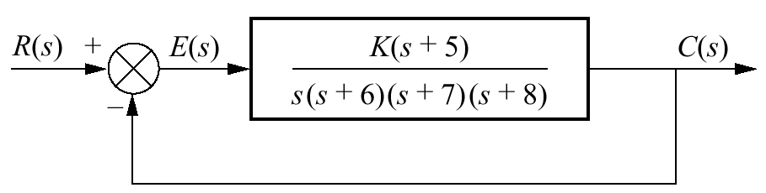



Example 7.6
Gain Design to Meet a Steady-State Error Specification
PROBLEM: Given the control system in the Figure, find the value of K so that there is 10% error in the steady state.
SOLUTION: Since the system is Type 1, the error stated in the problem must apply to a ramp input; only a ramp yields a finite error in a Type 1 system. Thus,

Slide 16
7.5 Steady-State Error for Disturbances

Slide 17
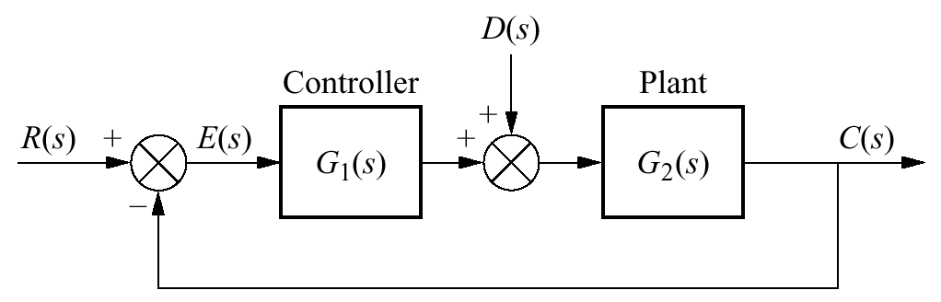

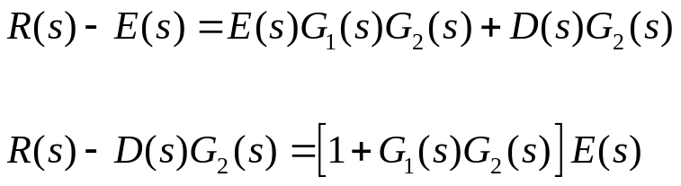
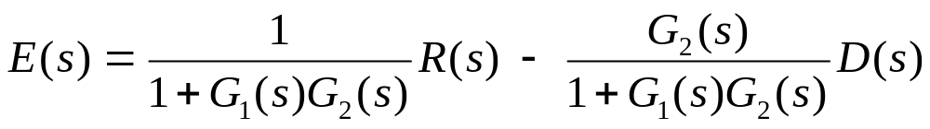
Figure 7.11
Feedback control system showing disturbance
transfer function relating E(s) to D(s)
transfer function relating E(s) to R(s)

Slide 18
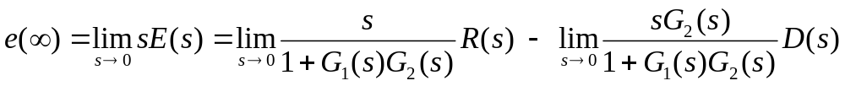
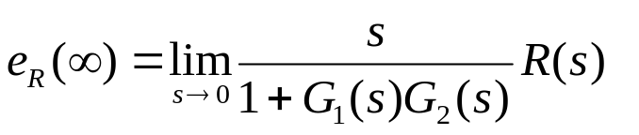
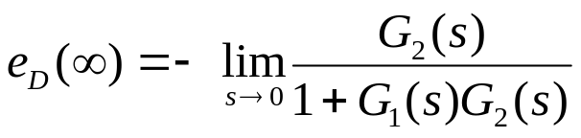
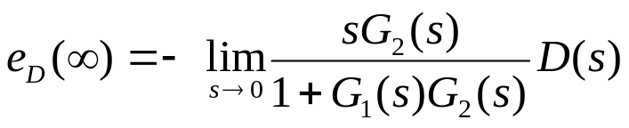
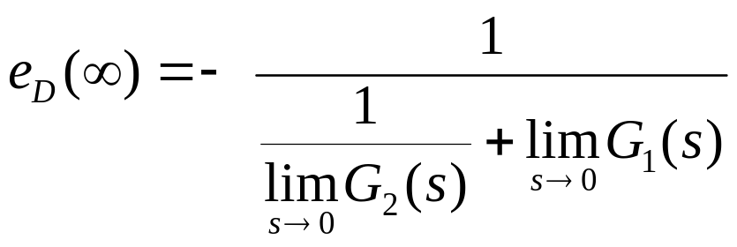

Applying the final value theorem
Assume a step disturbance,
D(s) = 1/s.
Let us explore the conditions on that must exist to reduce the error due to the disturbance

Slide 19
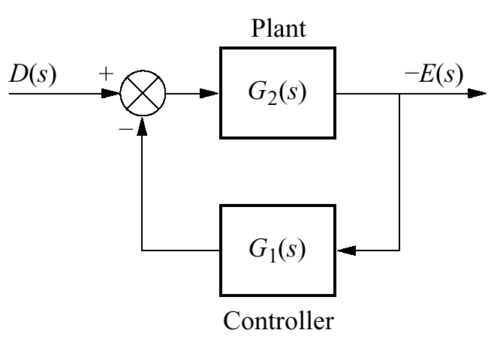
The ss error produced by a step disturbance can be reduced by:
increasing the dc gain of G₁(s)
or
decreasing the dc gain of G₂(s)
System rearranged to show disturbance as
input and error as output, with R(s) = 0

Slide 20
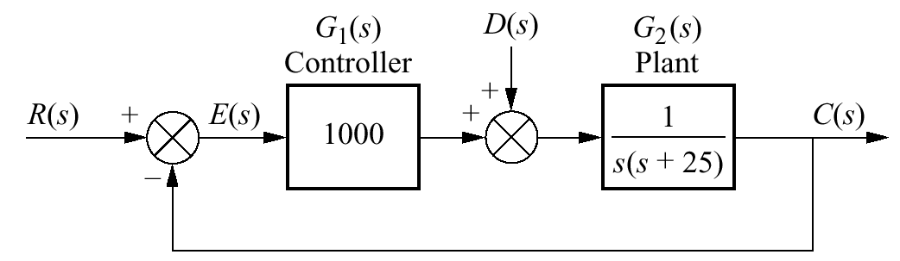
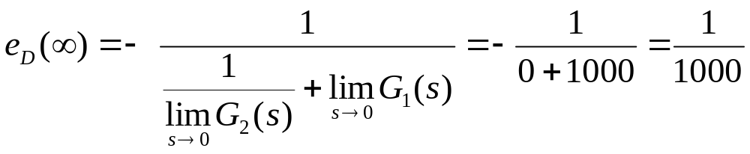
Example 7.7
Steady-State Error Due to Step Disturbance
PROBLEM: Find the steady-state error component due to a step disturbance for the system shown in the Figure.
SOLUTION: The system is stable
the steady-state error produced by the step disturbance is inversely proportional to the dc gain of G₁ (s)

Slide 21

???

